Slide 1
Review of Embedded Computing, Sensor Interfacing, Embedded System Design Process, CPS & ARM Cortex M3 and Cortex A Architecture

Slide 2
Review of Embedded Computing
Definition (Ref: Marilyn Wolf – Computers as Components)
An embedded system is a computing system designed to perform dedicated functions within a larger system, often under real-time constraints.
Characteristics
Dedicated functionality
Real-time operation
Resource constrained (memory, power, CPU)
Reactive & concurrent
High reliability

Slide 3
Review of Embedded Computing
Type | Example
Standalone | Washing machine
Networked | Smart meters
Mobile | Drones
Real-time | ABS braking system
Components
Processor (MCU/MPU/DSP)
Memory (Flash, SRAM)
I/O peripherals
Sensors & Actuators
Communication interfaces
Reference:
Marilyn Wolf – Computers as Components, Ch-1
Joseph Yiu – Ch-1

Slide 4
Interfacing Sensors with Embedded Systems
What is a Sensor?
A sensor converts physical quantity → electrical signal
Sensor | Parameter
LM35 | Temperature
LDR | Light
MPU6050 | IMU
MQ series | Gas
Ultrasonic | Distance

Slide 5
Interfacing Sensors with Embedded Systems
Interfacing Steps
Power supply
Signal conditioning
ADC conversion
Calibration
Software processing
Interfacing Methods
a) Analog Sensors
Output: Voltage
Interface via ADC Example: LM35 → ADC → Cortex-M3
b) Digital Sensors
Interfaces: I2C, SPI, UART Example: MPU6050 using I2C
Practical Issues
Noise filtering
Sampling rate
Resolution
Accuracy
Reference:
Marilyn Wolf – High Performance Embedded Computing, Ch-2
Joseph Yiu – Ch-9

Slide 6
Embedded System Design Process Design Flow (Ref: Marilyn Wolf)
Requirement Analysis
↓
System Specification
↓
Hardware/Software Partitioning
↓
Architecture Design
↓
Implementation
↓
Testing & Validation
↓
Deployment

Slide 7
Embedded System Design Process Design Flow (Ref: Marilyn Wolf)
Key Steps
1. Requirement Analysis
Functional
Timing
Power
Cost
2. HW/SW Co-design
Decide which part in hardware
Which part in software
3. Modeling
Data flow graphs
FSMs
UML
4. Verification
Unit testing
Integration testing
📚 Reference:
Marilyn Wolf – Computers as Components, Ch-3
Marilyn Wolf – High Performance Embedded Computing

Slide 8
Cyber Physical Systems (CPS)
Definition
CPS integrates:
Computation
Networking
Physical processes
CPS Architecture
Physical World → Sensors → Embedded System → Actuators
↑
Network

Slide 9
Cyber Physical Systems (CPS)
Features
Closed loop control
Real-time
Distributed
Safety critical
Examples
Autonomous vehicles
Smart grid
Medical devices
Robotics
📚 Reference:
Marilyn Wolf – High Performance Embedded Computing, Ch-5

Slide 10
ARM Cortex Processor Families
An ARM processor is a type of CPU based on the Reduced Instruction Set Computing (RISC) architecture,
known for its exceptional energy efficiency, lower power consumption, and cost-effectiveness,
making it dominant in mobile devices (smartphones, tablets) and increasingly powering laptops, servers, and embedded systems.
ARM Holdings designs the architecture and licenses it to companies like Apple, Qualcomm, and Samsung, who build the actual chips, rather than manufacturing them directly.
Family | Application
Cortex-M | Microcontrollers
Cortex-R | Real-time
Cortex-A | Application processors

Slide 11
CORETEX M3 MICROCONTROLLER FEATURES
It is a 32 bit processor offering many advantages over other microcontrollers.
It is a ‘harward architecture’.
For communication with Ram and Rom, this architecture provides separate instruction buses and data buses.
It consists of a 3 stage pipeline which fetches the instructions, then decodes it and then finally executes the instruction.
The memory required for the program has been reduced and also it provides high code density because of the usage of THUMB-2 technology in coretex-M3.
For the good interrupt performance, the core m3 is closely integrated to NVIC (Nested Vector Interrupt Controller).

Slide 12
CORETEX M3 MICROCONTROLLER FEATURES
It is a Reduced Instruction Set Computing (RISC) controller.
It has a high-performance CPU of 32 bits, and the pipelining is done through 3 stages.
The Thumb-2 technology has been integrated in these controllers, which means they can handle 16-bit as well as 32-bit instructions.
This technology also provides high performance in operations and executions.
It has low power modes. Sleep modes are also supported by it.
It controls the software efficiently, and it consists of multiple domains of power.
The NVIC, Nested Vectored interrupt controller, provides low latency as well as low jitter interrupt response.
Another advantage is that there is no need of assembly programming in it.

Slide 13
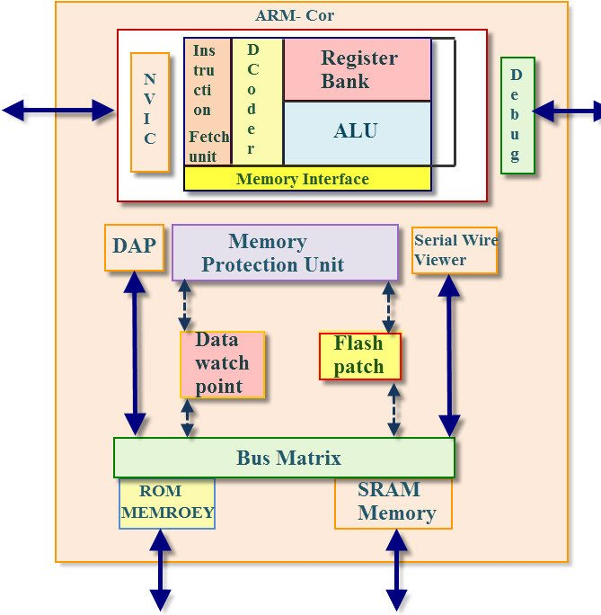
ARM Cortex-M3 Architecture 📚 Ref: Joseph Yiu – Ch-2,3

Slide 14
ARM Cortex-A Architecture
The Arm Cortex-A architecture defines high-performance, power-efficient CPU cores for complex tasks, powering smartphones, tablets, servers, and automotive systems, supporting rich OSs and applications with features like virtualization, TrustZone security, and advanced SIMD (NEON).
Key architectural shifts include ARMv7-A (32-bit) for older cores (A5, A7, A9) and the significant ARMv8-A (introducing 64-bit AArch64) for newer cores (A53, A57, A72, A75, A78, A720), with ARMv9-A bringing further advancements for AI/ML and safety-critical applications
.These cores often work in big.LITTLE or DynamIQ configurations for optimal performance and efficiency

